Slide 1

Text Category Classification
Under supervision of Dr. Wael Hassan
Steven Hany
210991
Mina Samir
212257

Slide 2

Introduction
Text category classification is the process of automatically classifying text documents into predefined categories or classes based on their content. It involves analyzing the features of a text, such as its vocabulary, syntax, and semantic meaning, and using machine learning algorithms to classify the text into one or more categories.

Slide 3

Project idea
In this project, we worked on a model that takes text as input and classifies that text into one of the categories it trained on.

Slide 4

Agenda
Dataset(AG News)
Libraries and coding
Training
Evaluation
Input handling
Assumptions

Slide 5

Dataset (AG News)
The AG News dataset is a collection of news articles with each article belonging to one of four categories: World, Sports, Business, and Sci/Tech.
The articles were collected from more than 2,000 news sources. The articles are preprocessed and stored in a CSV file format, with each row containing the article's label and text

Slide 6

Dataset (AG News)
AG news comes with two files train.csv and test.csv and topics are presented as numbers. So, we need to merge the two files into one so that we can split the all the dataset to train, valid, and test sets
replace the numbers in this dataset to their corresponding topic. We created a ipynb file (ag_news_merge.ipynb) and wrote a code to do all of that.

Slide 7

Libraries
Pandas
Numpy
Gensim.downloader
Train_test_split(Sklearn)
Tensorflow
TensorFlow.Keras.preprocessing

Slide 8

Coding Steps
Load pre-trained word2vec model(Google News)
Dataset Summary
Splitting data and Preprocessing
Model building

Slide 9

Load pre-trained word2vec model(Google News)
genism.downloader to download and load the word2vec pretrained model “word2vec-google-news-300”.
The Google News word2vec model is a pre-trained model that was trained on a large corpus of news articles. It contains 300-dimensional vectors for over 3 million words and phrases(using CBOW)

Slide 10

Dataset Summary
AG news has 127598 rows
4 number of Topics
Topics are:
Science and technology news(31900 rows)
Sports news (31900 rows)
World news (31900 rows)
Business news(31898 rows)

Slide 11

Splitting the data
Descriptions in the dataset were divided to 20% for test data and 20% for validation data and 60% for training data

Slide 12

Preprocessing
tokenize the text data using the Tokenizer class from the Keras preprocessing module.
After tokenization every string change to lower and making padding and change the special characters in the text data.
Convert the text data to sequence and pads the sequence to a fixed-length specified in variable called max_text_length,using the pad_sequences() function from the Keras preprocessing module.
Matrix called Vector matrix containing word embeddings for each word in the vocabulary learned by the Tokenizer object.

Slide 13

Model building
Sequential model using the Keras API in TensorFlow for text classification with Bidirectional LSTM
Input layer of size sequence array we made after converting the text data to sequence
Second layer for embedding to maps the words in the input sequence to their corresponding pre-trained word embeddings

Slide 14
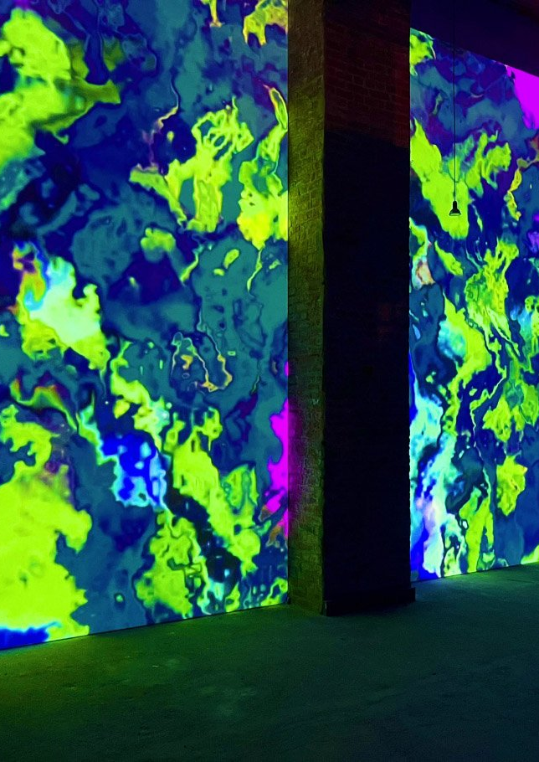
Model building (cont.)
Layer to add a bidirectional model with neural units equal to 32 and dropout rate of 0.4
Another layer to dropout with dropout rate equal to 0.4
Dense layer with 32 units, and using RELU activation function
Output layer add a final dense layer to the model with 4 unit(number of topics) and softmax activation function

Slide 15
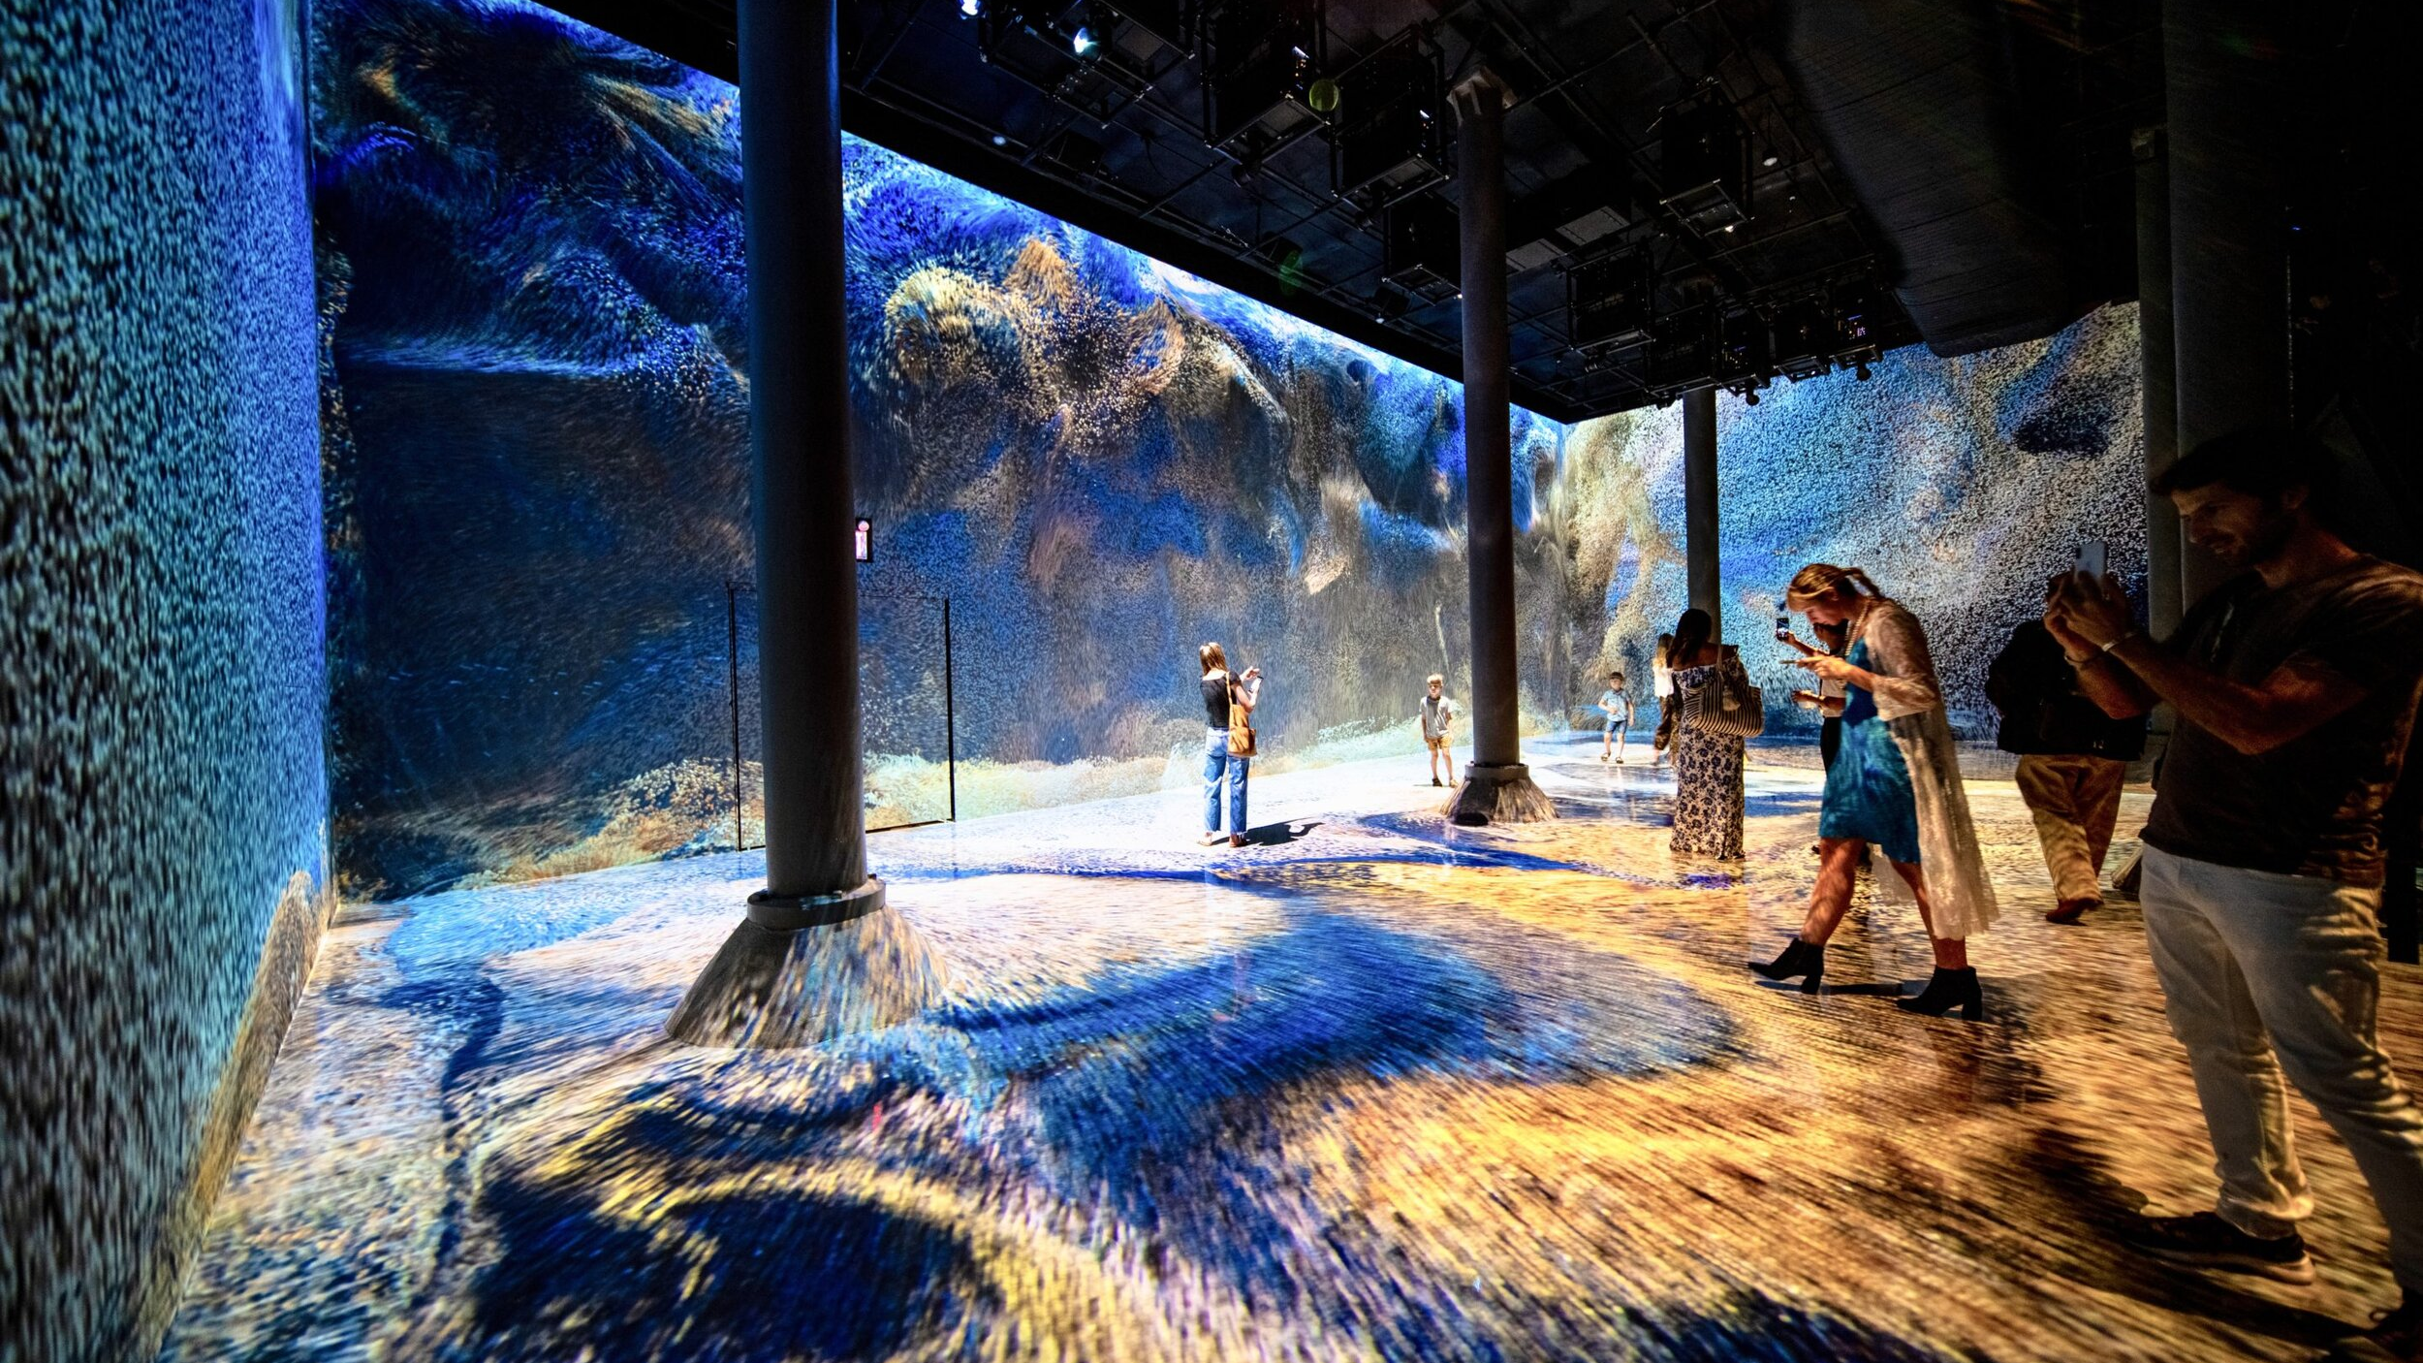
Model building (cont.)
Layer for optimizer using adam optimizer with learning rate equal 0.01 and loss function is categorical_crossentropy with metrics to track during the training(accuracy).

Slide 16

Training
start to train the model with fitting to compiled keras model using the training data and validating it using the validation data using model.fit()
The output of model.fit() is a History object, which contains information about the training and validation loss and accuracy at each epoch.

Slide 17

Evaluation
After training model produce the accuracy for training data equal 88.33%
Accuracy for Valid data equal 89.21%
Accuracy for Test data equal 89.38% with loss=0.3185

Slide 18

Input handling
tokenize the input string using the same tokenizer and padding in the sequence with zeros.
predict the array of probabilities, and confidence_Score will take the greatest score of this array.
Take this 2D-array and convert it to string using inverse_transform function.

Slide 19

Assumptions
The value of Dropout changed many times till it reach to 0.4 to make sure that there is no overfitting, and same with number of neurons in the layers for the model to make it balanced

Slide 20

Any Questions ?

Slide 21

Thanks

